Slide 1
Sessions 4
Basic cryptographic Terminologies
Caeser cipher
playfair cipher

Slide 2
Cryptography
1. Symmetric key Cryptography
2. Public key cryptography
Symmetric cryptography was only type prior to invention of public-key in 1970’s and by far most widely used (still) is significantly faster than public-key crypto

Slide 3
Some Basic Terminology
Plaintext
Ciphertext
Encryption algorithm / cipher
key
Decryption algorithm
Cryptography
Cryptanalysis
Cryptology

Slide 4
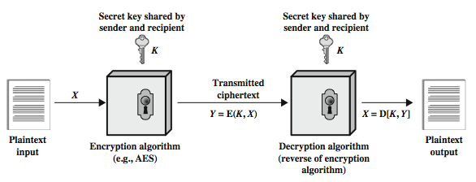
Symmetric Cipher Model

Slide 5
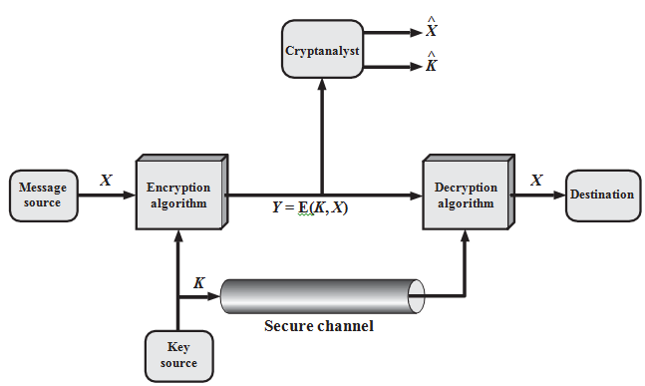

Slide 6
Requirements
Two requirements for secure use of symmetric encryption:
  a strong encryption algorithm
  a secret key known only to sender / receiver
Mathematically
  Y = E(K, X) = E_{K}(X)
  X = D(K, Y) = D_{K}(Y)
Assume encryption algorithm is publicly known, so the security rely upon the secrecy of key alone.
A secure channel is required to distribute the key, this is a big problem in symmetric cryptography

Slide 7
Cryptographic algorithms are characterized by:
  Type of encryption operations used
    substitution, transposition, product
  Number of keys used
    single-key, two-key
  way in which plaintext is processed
    block, stream

Slide 8
Cryptanalysis
Objective to recover key not just message
General approaches:
  cryptanalytic attack
  brute-force attack

Slide 9
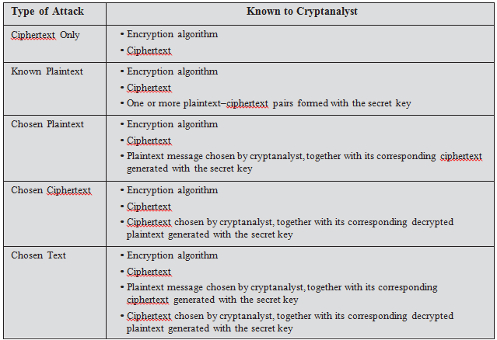
Cryptanalytic Attacks

Slide 10
Brute Force Attack
Try every possible key
Key Size (bits) | Number of Alternative Keys | Time required at 1 decryption/µs | Time required at 10⁶ decryptions/µs
32 | 2³² = 4.3 × 10⁹ | 2³¹ µs = 35.8 minutes | 2.15 milliseconds
56 | 2⁵⁶ = 7.2 × 10¹⁶ | 2⁵⁵ µs = 1142 years | 10.01 hours
128 | 2¹²⁸ = 3.4 × 10³⁸ | 2¹²⁷ µs = 5.4 × 10²⁴ years | 5.4 × 10¹⁸ years
168 | 2¹⁶⁸ = 3.7 × 10⁵⁰ | 2¹⁶⁷ µs = 5.9 × 10³⁶ years | 5.9 × 10³⁰ years
26 characters (permutation) | 26! = 4 × 10²⁶ | 2 × 10²⁶ µs = 6.4 × 10¹² years | 6.4 × 10⁶ years

Slide 11
Classical Substitution Ciphers
A character of plaintext is replaced by another character
or
A sequence of bits of plain text is replaced by another sequence of bits

Slide 12
Caesar Cipher
It replaces each letter by next 3rd letter
example: meet me after the toga party
  PHHW PH DIWHU WKH WRJD SDUWB
Can define transformation as:
  a b c d e f g h i j k l m n o p q r s t u v w x y z = IN
  D E F G H I J K L M N O P Q R S T U V W X Y Z A B C = OUT
If a=0, b=1, … z =25, then
  c = E(k, p) = (p + k) mod (26)
  p = D(k, c) = (c – k) mod (26)

Slide 13
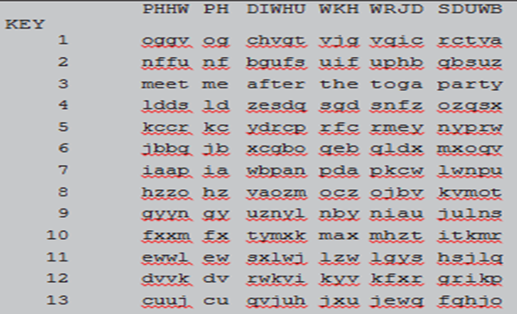
Brute-Force Cryptanalysis of Caesar Cipher

Slide 14
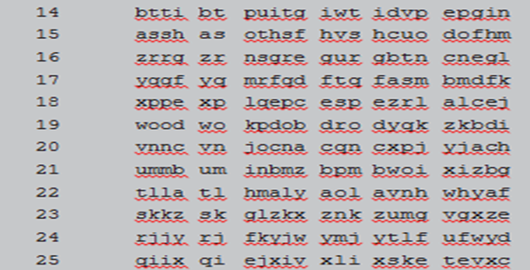
Brute-Force Cryptanalysis of Caesar Cipher

Slide 15
Monoalphabetic Cipher
Rather than just shifting the alphabet could shuffle the letters arbitrarily
Each plaintext letter maps to a different random cipher text letter
Hence key is 26 letters long
  Letters: abcdefghijklmnopqrstuvwxyz
  Key : DKVQFIBJWPESCXHTMYAUOLRGZN
  Plaintext: ifwewishtoreplaceletters
  Ciphertext: WIRFRWAJUHYFTSDVFSFUUFYA
  26! Keys are possibe, is it secure ? No.

Slide 16
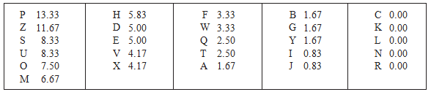
Language character frequency analysis
cipher text (120 characters) =
ZQSOVUOHXMOPVGPOZPEVSGZWSZOPFPESXUDBMETSXAIZ VUEPHZHMDZSHZOWSFPAPPDTSVPQUZWYMXUZUHSX EPYEPOPDZSZUFPOMBZWPFUPZHMDJUDTMOHMQ
The relative frequencies of the letters in the cipher text in % :
Compare this frequencies with a standard frequency distribution

Slide 17
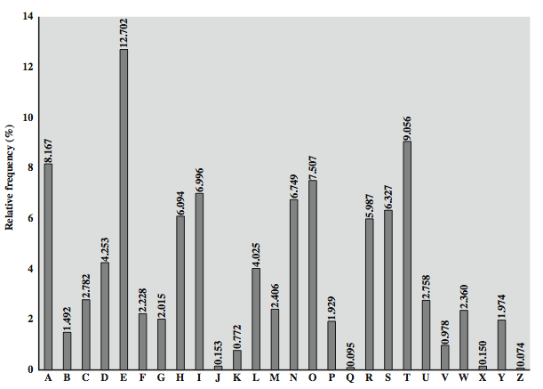
English Letter Frequencies

Slide 18
English Letter Frequencies
It seems likely that cipher letters P and Z are the equivalents of plain letters e and t, but it is not certain which is which.
The letters S, U, O, M, and H are all of relatively high frequency and probably correspond to plain letters from the set {a, h, i, n, o, r, s}.
The letters with the lowest frequencies (namely, A, B, G, Y, I, J) are likely included in the set {b, j, k, q, v, x, z}.
Next we can analyze 2 letters, 3 letters and 4 letters

Slide 19
Playfair Cipher
Not even the large number of keys in a monoalphabetic cipher provides security
So we can go for multiple letters substitution at a time
The Playfair Cipher is an example of 2 letter substitution at a time

Slide 20
Playfair Key Matrix
A 5X5 matrix of letters based on a keyword
fill the letters of keyword in table first, then other other letters
using the keyword MONARCHY the table is
M | O | N | A | R
C | H | Y | B | D
E | F | G | I/J | K
L | P | Q | S | T
U | V | W | X | Z
Plain text:
balloon
ba lx lo on
Cipher text:
ib su pm na

Slide 21
Encryption
plaintext is encrypted two letters at a time
  if a pair is a repeated letter, insert filler like 'X’.
  For example- balloon becomes ba lx lo on.
  if both letters fall in the same row, replace each with a letter right of it.
  if both letters fall in the same column, replace each with the letter below it.
  otherwise each letter is replaced by the letter in the same row and in the column of the other letter of the pair.

Slide 22
Play fair Example
Message = Move forward
Plaintext = mo ve fo rw ar dx
Here x is padded to make even number of characters
Ciphertext =
M | O | N | A | R
C | H | Y | B | D
E | F | G | I/J | K
L | P | Q | S | T
U | V | W | X | Z

Slide 23
Security of Playfair Cipher
Security is much improved over monoalphabetic cipher, because 26 x 26 = 676 pairs are possible.
We need a 676 entry frequency table to analyse (versus 26 for a monoalphabetic)
It was widely used for many years by US & British military
It can be broken, given a few hundred letters

